Slide 1


Sensitivity to Envelope and Pulse Timing Interaural Time Differences in Prosthetic Hearing
Shiyi FANG¹, Fei Peng¹, Bruno Castellaro¹, Muhammad Zeeshan¹, Nicole Rosskothen-Kuhl², Jan Schnupp¹
¹Department of Neuroscience, City University of Hong Kong
²Neurobiologisches Forschungslabor, University of Freiburg Medical Center

Slide 2
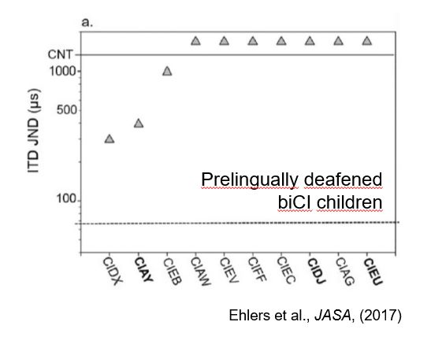
The best ITD threshold prelingually deafened Bi-CI children can reach is 300 μs
Δ µs
Left ear
Δ dB
Right ear
Notes:
the difference in arrival time of a sound between two ears

Slide 3
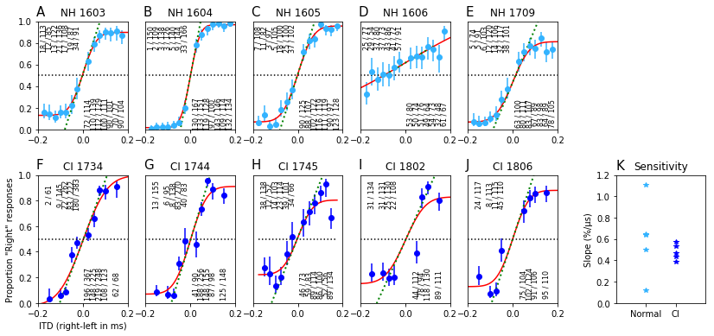
Neonatal deaf rats have comparable ITD sensitivity to normally hearing rats
Li K, Chan CH, Rajendran VG, Meng Q, Rosskothen-Kuhl N, Schnupp JW. (2019) J Acoust Soc Am. doi.org/10.1121/1.5099164
Rosskothen-Kuhl, N., Buck, A. N., Li, K., & Schnupp, J. W. (2021) Elife , 498105; doi: DOI: 10.7554/eLife.59300
Notes:
ND rat show good ITD sensitivity which is comparable to NH rat, make us think the bad ITD ability of bi-CI patient is the current encoding strategy is not providing appropriate ITD cues

Slide 4
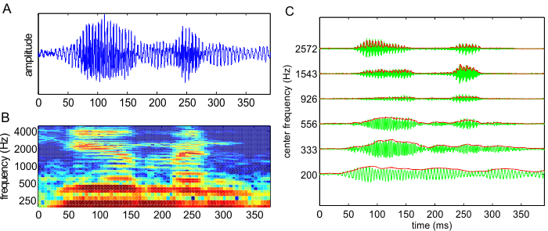
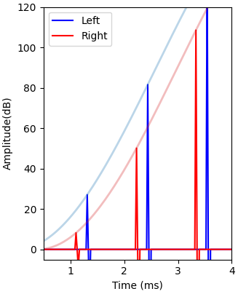
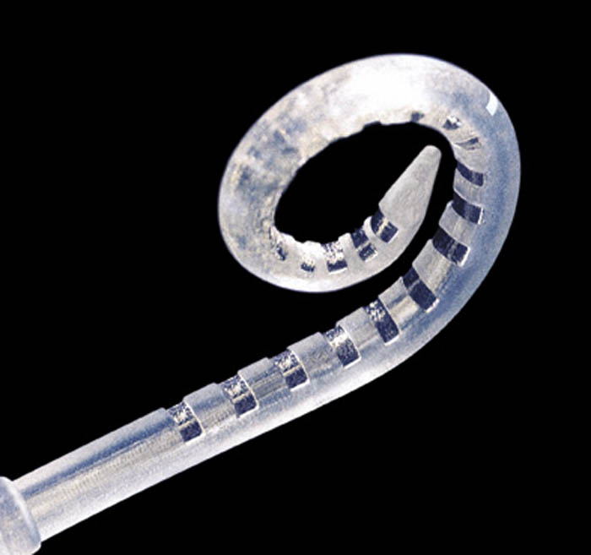
Acoustic sound signal
Continuous Interleaved Sampling (CIS) provides veridical ENV_ITD cues but randomized PT_ITD cues
The fine structure of the electrical stimulation is independent of the fine structure of the incoming sound
Unsynchronized CI processor
ENV_ITD
PT_ITD
Notes:
4
Each ear: CIS bandpass the acoustic sound and take the envelope to modulate the default pulse train set for each channel ring and pass electrical stimulus to AN
CIS encode ITD cues in envelope ITD but the pulse timing ITD is consist by default
The zoom in simulate what the stimulus like when its bilateral and only single channel for each ear is activate.
Point out ENV_ITD and PT_ITD and in the example the envelope blue is leading but pulse timing red is leading (just an example)
(but the auditory system is not sensitive to the ENV_ITD at all but sensitive to PT_ITD and current strategy is not providing correct pt-itd might be the reason why bi-CI patient bad spatial hearing perception)

Slide 5
Research Question
How sensitive can the hearing inexperienced auditory system be to envelope (ENV) ITDs and pulse timing (PT) ITDs respectively?
What if ENV and PT ITDs conflict?

Slide 6
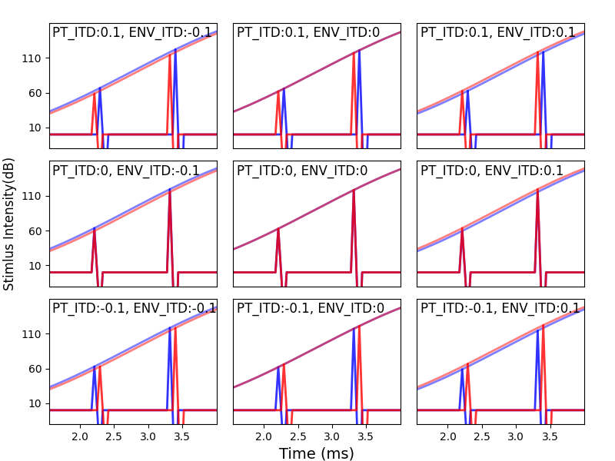
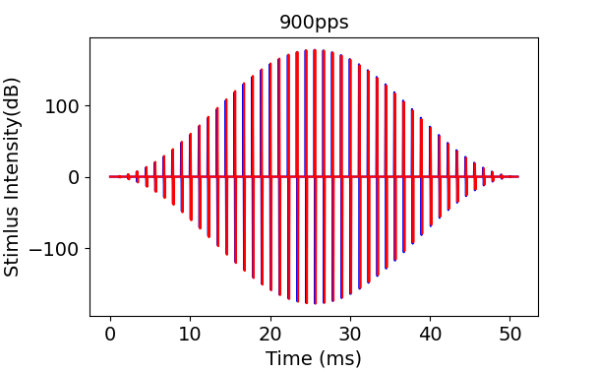
Stimulus
PT_ITD: {-0.1, 0, 0.1} ms
ENV_ITD:{-0.1, 0, 0.1} ms
Hanning envelopes of either 50 or 200 ms width.
Negative ITD values mean left ear leading.
Notes:
Why 900pps and 4500pps?
900pps: normally the CI processor use pulse rate around 900pps to 1200pps
Why 3 different duration

Slide 7
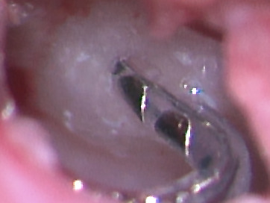
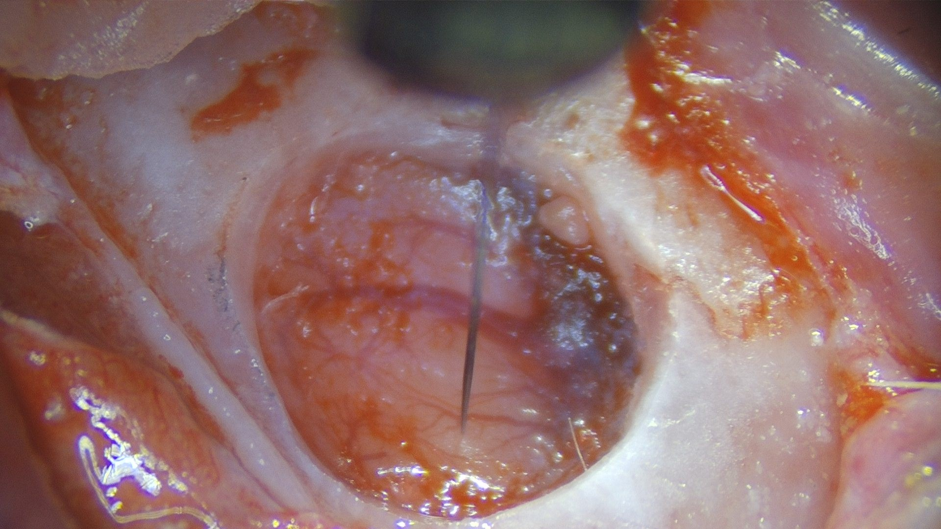
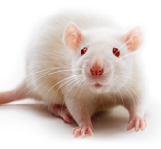


The animal model
Kanamycin, P9-20
Neonatally Deafened
(n=4)
432 multiunits recorded in IC of 4 ND biCI rats
Notes:
To answer these questions we used again normal hearing rats and neonatally deafened rats….
Normal hearing or loss of hearing function was verified by measuring auditory brainstem responses to click stimuli presentation via in-ear headphones
Lets start with the group of normally hearing rats…..

Slide 8
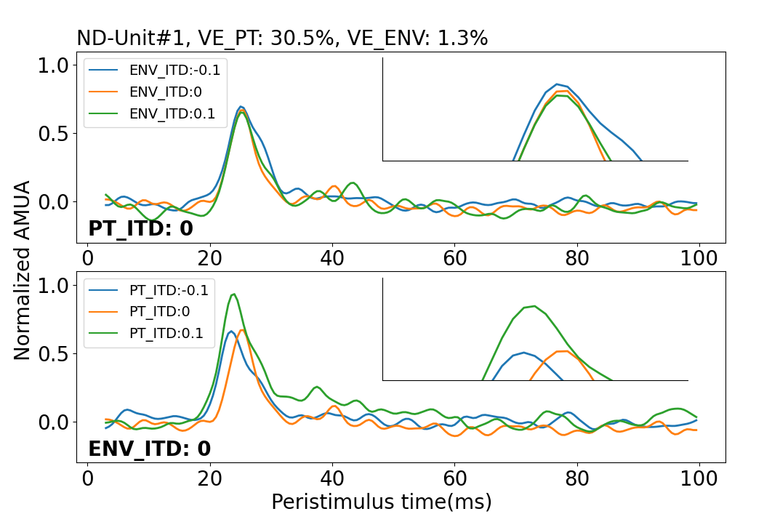
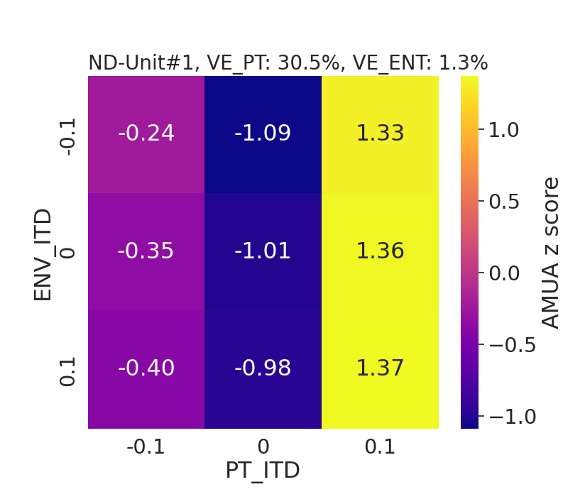
Example Multiunit:
Clear Dependence of Response on PT_ITD but not ENV_ITD

Slide 9
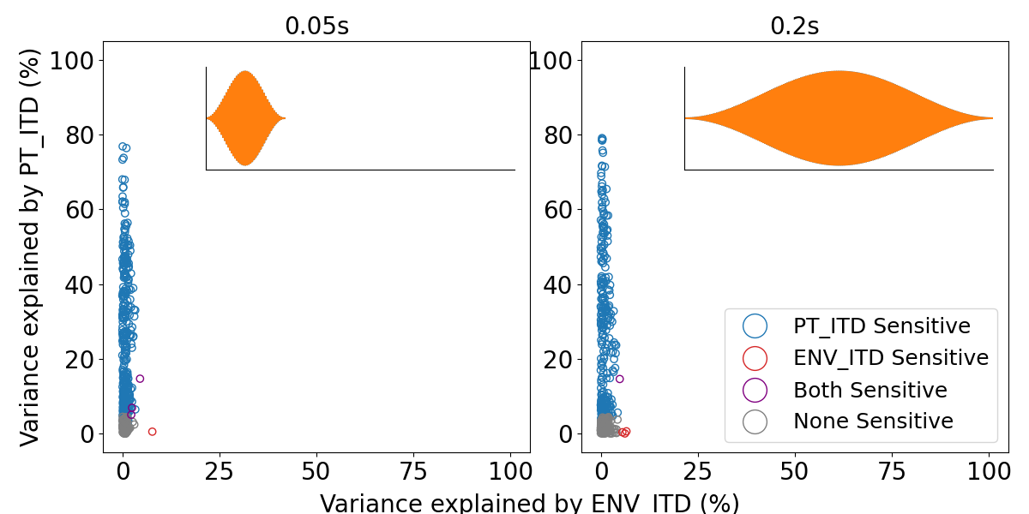
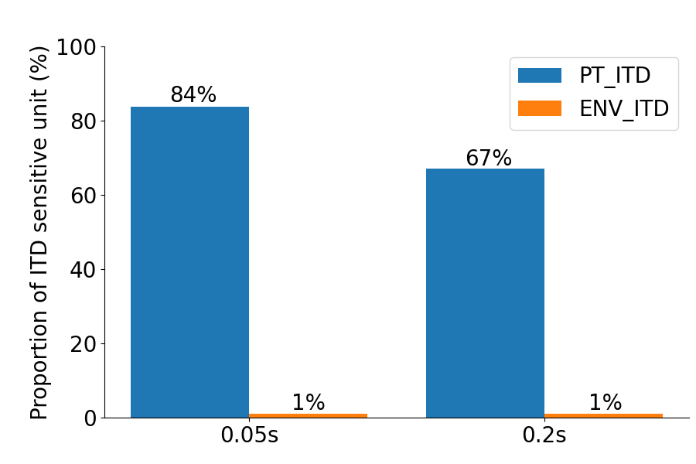
PT_ITD, not ENV_ITD, Explains the Lion’s Share of the Variance in Neural Responses

Slide 10
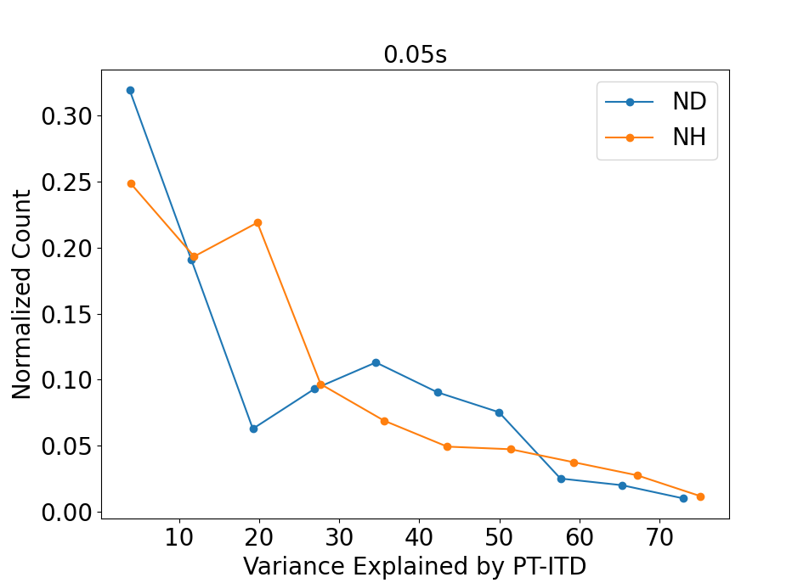
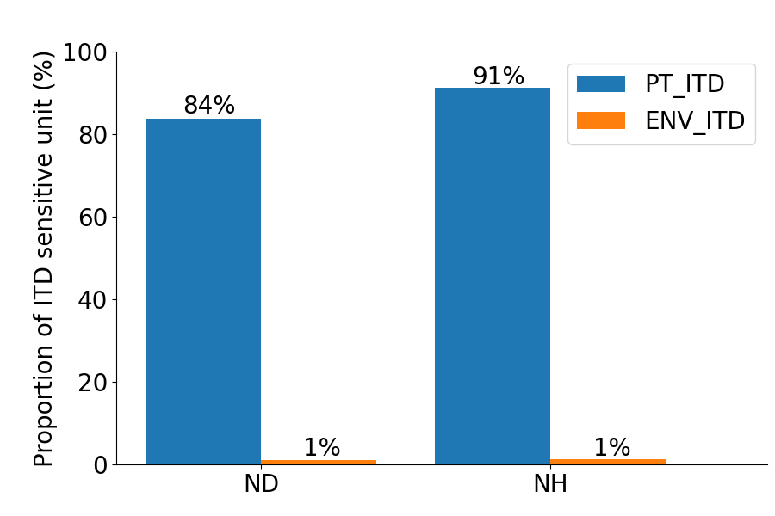
Histogram of Variance Explained by PT_ITD in ND is Comparable to Normal Hearing (NH)

Slide 11
Summary
Over 60% of multi-units are sensitive to PT_ITD
IC is much more sensitive to PT_ITD than ENV_ITD
Current CI encoding strategy encode time difference information into ENV_ITD rather than PT_ITD, which the IC is much less sensitive to. Random PT_ITDs will, at least initially, dominate ENV_ITDs. This is bound to contribute to bad spatial hearing outcomes.

Slide 12








Acknowledgements
PS: we will be hiring Post Docs, RAs and PhD students. If you are interested in a job in fabolous Hong Kong, email jan@schnupp.net or approach Jan at this meeting.

